Slide 1
Biology on a Budget: Shareable D.I.Y. Biology Lab Activities
Larry MacPhee
Associate Director of e-Learning
(and part time Biology instructor)
Northern Arizona University

Slide 2
Thanks to the SICB Ed Council and Dr. Bram Lutton for providing the beverages & sweets that lured you here!
Thanks for coming out to this workshop when you could be out exploring an amazing city. I will try to make it worth your while.

Slide 3


Challenges!
The Course Content
Sometimes poor
Lecture heavy
Expensive and/or Copyrighted
The Instructor
Part time? New Hire? Overextended?
Little pedagogical training
Few engaging activities
Notes:
We teach the way we were taught
Trend towards part-time, low paid instructors
I was a young science teacher once…content knowledge but no engaging activities
We’re all reinventing the wheel

Slide 4
What’s so great about labs?
Hands-on (active learning)
Inquiry based (hypothesis driven)
Things can go wrong (that’s ok!)
Make you think (critical thinking)
Labs can be fun!
Put theory into practice
Labs make it memorable
Notes:
Labs support the lecture
Active learning is all the rage in pedagogy, but labs have been doing it for centuries

Slide 5
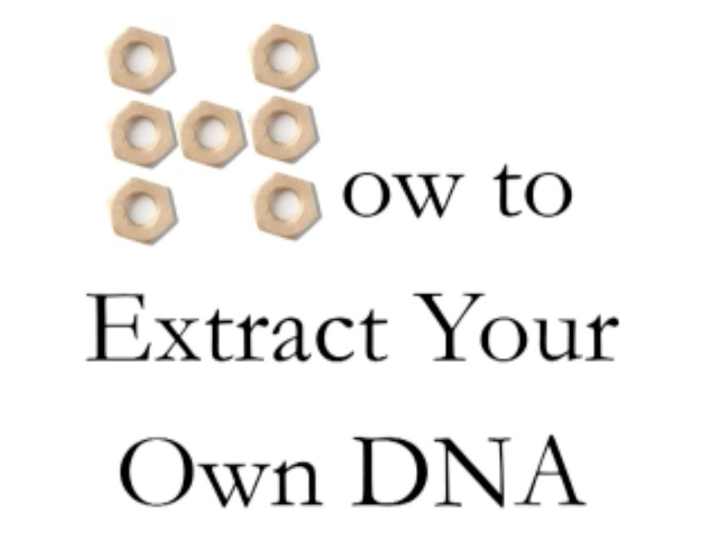
A Good Example
http://www.pbs.org/video/2203057166/
Notes:
http://www.pbs.org/video/2203057166/
If you’ve only seen DNA extracted on CSI, this is a revelation

Slide 6
D.I.Y.
Most of what you need is at the…
Grocery Store
Pharmacy
Hardware Store
In your kitchen

Slide 7
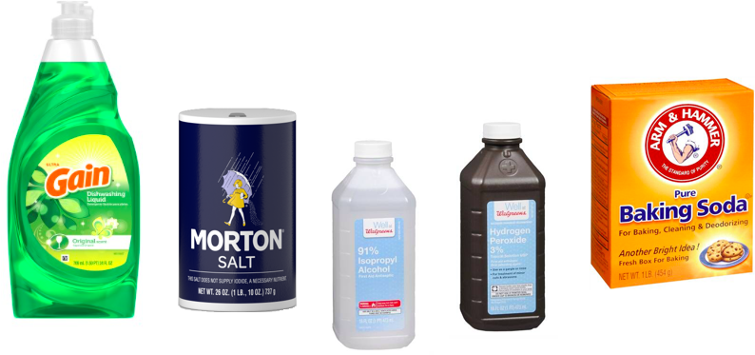
Common Household Chemicals

Slide 8
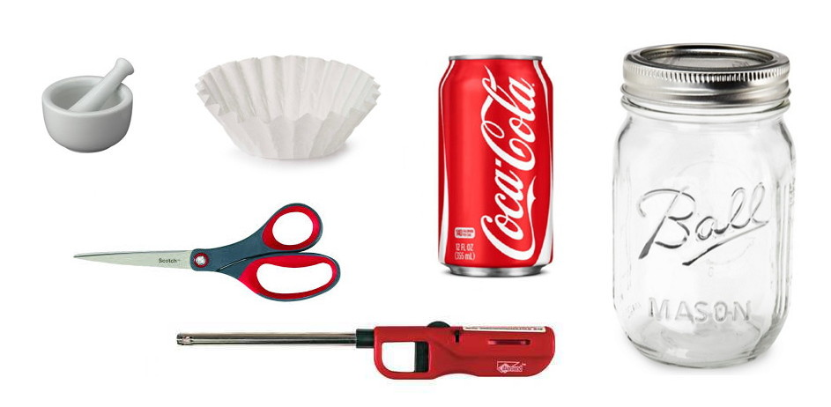
Common Kitchen Items

Slide 9
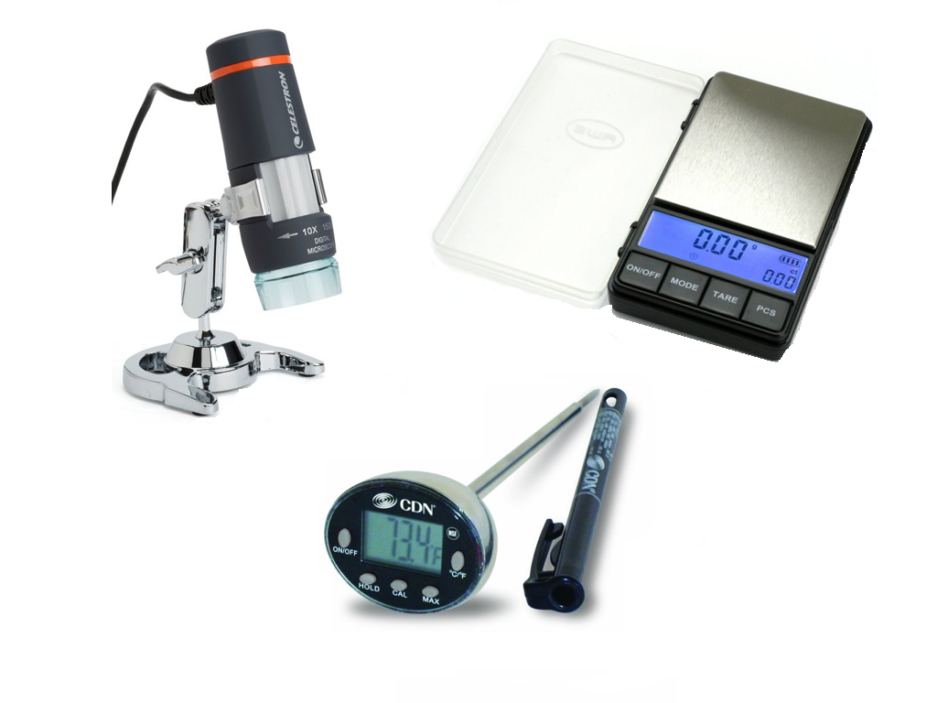
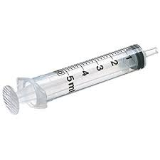
Inexpensive Equipment
Join the mailing list to enter the equipment raffle!
Notes:
For digital microscopes, maybe a purchase and re-sell program through your bookstore?

Slide 10
The Plan!
Time | Activity
7:00 pm | Desserts and Coffee/Tea
7:10 pm | Brief Intro & Overview
7:15 pm | Full group Activity 1: Disease Transmission
7:30 pm | Conduct activity 2, reset station, move next
7:45 pm | Conduct activity 3
8:00 pm | Conduct activity 4
8:15 pm | Conduct activity 5
8:30 pm | Conduct activity 6
8:45 pm | Follow-up Discussion

Slide 11
15 minutes per table
Calorie Lab
Nut vs Cracker
Felt-tip pen
Chromatography
Population Ecology Simulations
Bird Beak
Competition
Water Drops
Scientific Method
DNA Extraction

Slide 12
Small Group Assignments
Self-assort into small groups of equal size
Chose your role within the group
Group Manager: assigns work, resolves conflicts
Experimenter: hands-on person, conducts experiment
Data Collector: records process, collects data
Data Analyzer: makes graphs, interprets data
Presenter: public speaker, big-picture, summarizer

Slide 13
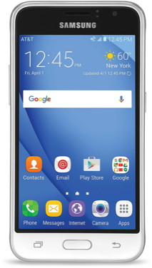
Record the Event!
Please take pictures and/or video…
e-mail to Larry.MacPhee@nau.edu

Slide 14
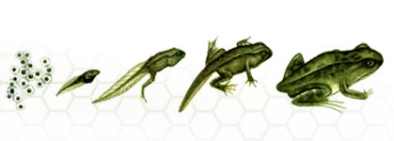
The Labs…
www2.nau.edu/lrm22/lessons
Please join the mailing list!

Slide 15
Discussion

Slide 16
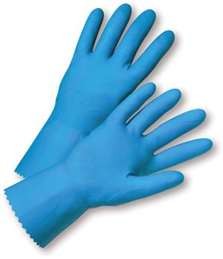
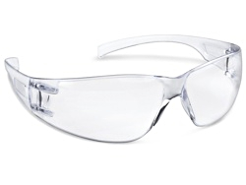
What about safety?
Liability?
Mandatory Safety Quiz
Animal Care Protocol

Slide 17
How do you assess it?
Send me
Lab setup “selfie” or video
Results graph or data table
Responses to thinking questions
Mini Lab Report
Notes:
Some or all of these, as appropriate to the lab
The readers digest version of a lab report
What did you do?
Why did you do it?
What did you find?
What does it mean?

Slide 18
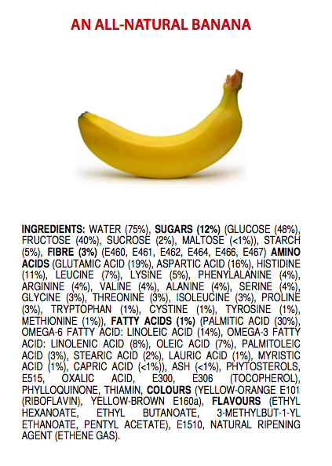

Science Literacy +
Critical Thinking Skills
Notes:
My god, bananas are full of chemicals!
Even for people who don’t go on in biology, like healthcare professionals, the general public
So much confusing/false information about diet, health
Appeals to conspiracy theories, undermines real science
We should put our best instructors in 100 level, large enrollment courses

Slide 19
Non-scary Math
JAVA is problematic (especially on Mac)
Flash is almost dead (no good on iOS)
JavaScript is useful for simple things
Solution Calculator
Unit Converter
Timeline Generator
Excel works great and lets you tinker
Data recording and error free calculations (calorie lab)
Dynamic graphing (osmosis lab regression)
Playing with variables
  Predator-Prey
  Species Competition

Slide 20
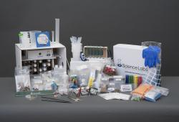
Commercial Kits
Order a kit?
Carolina
eScienceLabs
Science Buddies
Convenient, yes.
But DIY is cheaper, less “magical”
Notes:
Commercial outfits happy to sell you an expensive kit
Gathering materials, mixing solutions yourself de-mystifies the process

