Slide 1
Google Apps
for
Education
Larry MacPhee
Director
e-Learning
Northern Arizona University
Notes:
45 mins total for this presentation

Slide 2
Two e-mail systems at NAU
Faculty / Staff
Microsoft Exchange (IRIS)
firstname.lastname@nau.edu
Students
NAU GMail (Google)
nauid@nau.edu

Slide 3
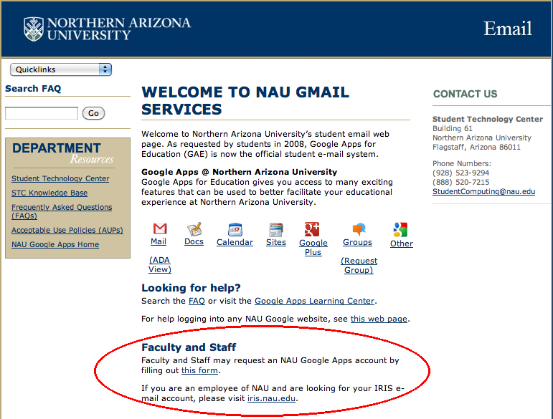
But...
Faculty & Staff can request an NAU GMail account
mail.nau.edu

Slide 4
With G-Account → Google Apps!
Microsoft Office | Google Equivalent
Word | Word Processor: Docs
Excel | Spreadsheet: Sheets
PowerPoint | Presentation: Slides
And More…

Slide 5

What’s wrong with Office?
I like Office.
I know Office.
Office is free (to me).
Office is powerful.
Office is the standard.
Office has clippy!

Slide 6
Collaboration in MS Office
(not so great)
You
  Create a document
  Send to colleague
  Wait for feedback…
Your collaborator
  Enable “track changes”
  Modify the document
  Return the document
You
  Review changes
  Accept or reject changes
Notes:
Track changes is useful, but it’s not that great. There’s a lot of waiting and a lot of back and forth.

Slide 7
Collaboration in Google Apps
Documents live in "the cloud"
Share the link, not the doc
Simultaneous editing
Multiple editors
Permissions
  Public/Private
  View/Edit/Share
Revision History, with Undos
Chat while you work

Slide 8
Advantages
Helps students on a budget
Discourages software piracy
Office feature overload
You always have the current revision
Still works when your computer dies!
Can use instead of or in addition to…
No worries with lost thumb drives!
G-Docs never needs updating*
Notes:
*Updates are automatic so everyone is always on the same version. This disadvantage is that you don’t get to decide when to upgrade, and the timing isn’t always convenient when the features change.

Slide 9
Disadvantages
Because updates are automatic…
You don’t have a choice
The timing can be inconvenient
Features change on Google’s timetable, not yours.
Compatibility with Office…

Slide 10
Compatibility?
MS Office ←Yes→ Google Docs
Pretty good, not perfect
Stick to the basics
and you’ll be fine.
Notes:
Microsoft doesn’t want to help Apple and Google at the expense of their own mobile devices.

Slide 11
Q: What's the biggest frustration with web-based services?
Remembering your username
Remembering your password
Forced password changes
Password naming restrictions
Different rules at different sites
$%&*)#$%^&*(!!!

Slide 12
Wouldn't it be great if web-based tools used your NAU credentials?
Your NAU Google username is:
nauid@nau.edu
Your NAU Google password is:
your NAU password

Slide 13
Getting there?
Start using Google Apps by visiting:
gdrive.nau.edu

Slide 14
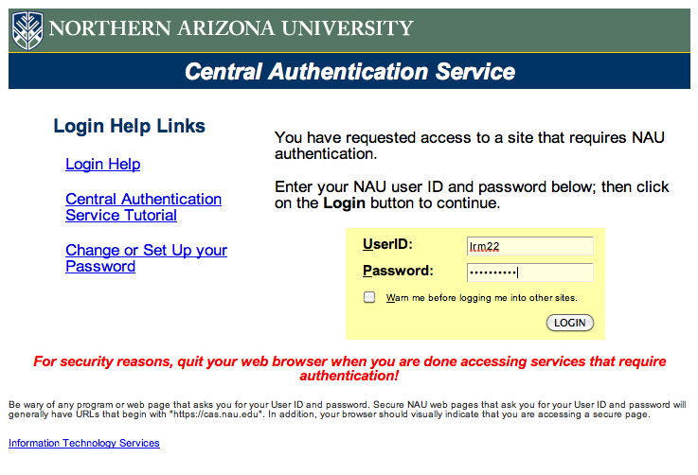
Log in with your usual credentials

Slide 15

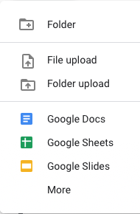
Click the “+ New” button…

Slide 16
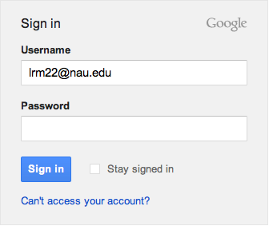
Just one tricky thing!
Don’t enter a password here:
Notes:
Just enter your NAU username and then click Sign In, without a password. This is the login for the public Google, not the NAU Google. You need to be redirected.

Slide 17
Let’s try it out…
Demonstrations:
Create a Doc and Share it…
  (will need your NAU IDs)
Collaborative Word Processing
Import a PPT to Google Docs
Take a survey
Create a survey

Slide 18
TIP: Really Long URLs
GoogleApps make really long URLs
Use bit.ly or tinyurl.com to shorten them

Slide 19
Questions?
Larry.MacPhee@nau.edu

