Slide 1
Blackboard Learn Training at NAU
Larry MacPhee
Associate Director of e-Learning
Northern Arizona University

Slide 2
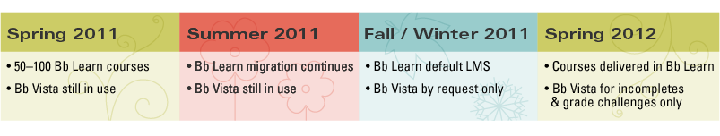
From Vista to Bb Learn
Our timeline

Slide 3
Bb Workshops
Introduction to Bb Learn
Organizing Content
Communicating with Students
Grading Student Work
Developing Learning Activities
Your Migrated Course
Notes:
Six workshops cover the basic topics.

Slide 4
Incentives
Complete any 4 workshops
$200

Slide 5
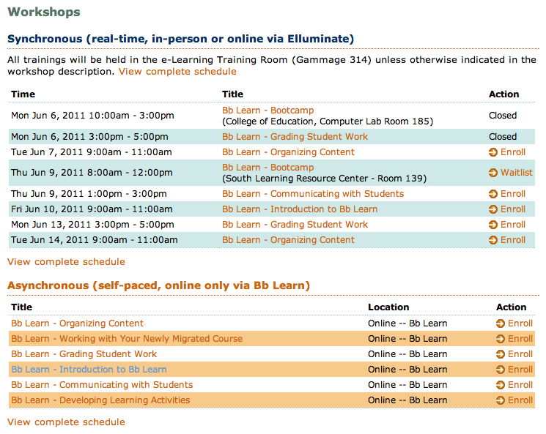
Registration
http://www.nau.edu/d-elearn/training
Notes:
People enroll in our training using a web database. When they enroll in training, this lets us know to enroll them in our Blackboard training courses.

Slide 6
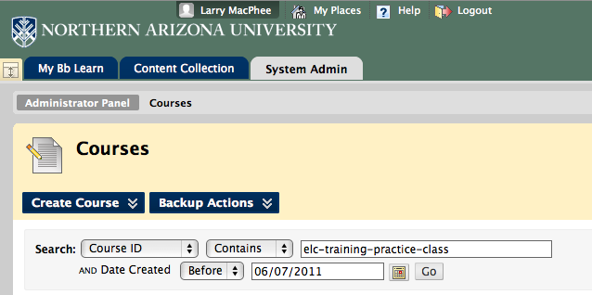
Preparation
Create Individual Shells
Enroll All as Students
Notes:
We create a practice class or “sandbox” for every trainee, where they are enrolled as designers and can safely try new things. This class remains accessible to them forever.
We also enroll all trainees as students in a training workshop class where they can interact with each other as students would.

Slide 7



Training: 3 ways
Notes:
Three training modes: In-person live, distance live with Elluminate/Collaborate, and self-paced, using Blackboard.

Slide 8
Methods
Hands-on
Activity based
Student perspective
  Participate
Instructor perspective
  Build Content
Notes:
Learn by doing. Experience Blackboard first from the student perspective and then as an instructor/designer.

Slide 9

In person
Come to us
Notes:
Small group in-person training is favored by many faculty.

Slide 10
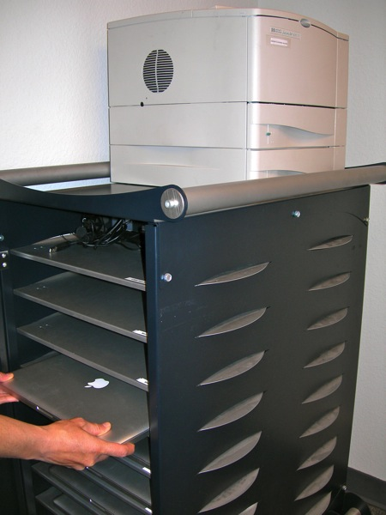
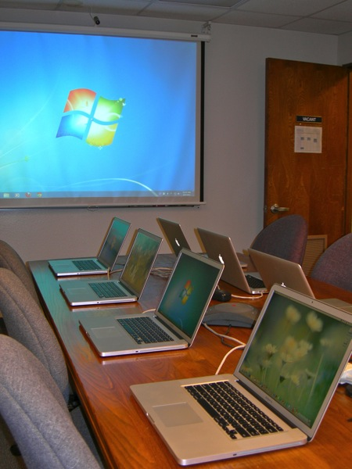
In person
We’ll come to you
Notes:
We sometimes take the training on the road and deliver a workshop for a department or special group.

Slide 11

In person
Mac or Windows?
Notes:
We use dual-boot machines so that our trainees can pick the OS and browser with which they are most familiar.

Slide 12
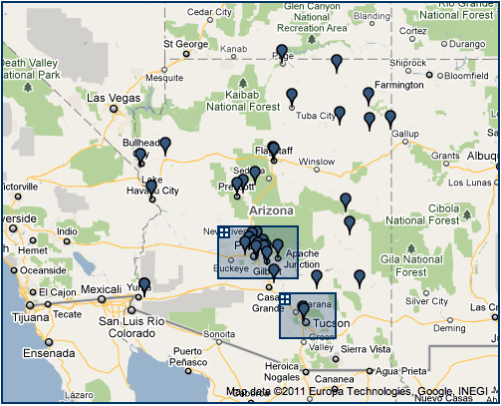
Distance Training
34 NAU Statewide Sites
Notes:
NAU has 34 statewide sites where in-person classes are offered. Many of these sites are rural and a number are on the Navajo reservation.

Slide 13
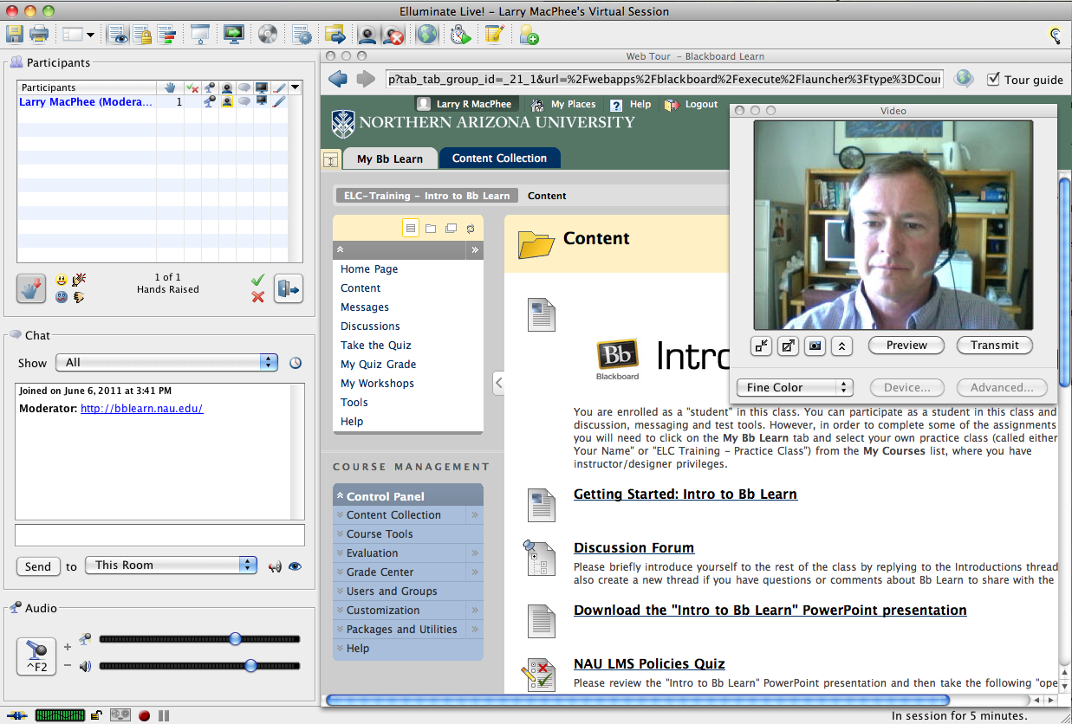
Distance, Live
http://elluminate.nau.edu
Notes:
We do live training to people at a distance, but it helps if they are familiar with the communications tool.

Slide 14

Distance, Self-paced
http://bblearn.nau.edu
Notes:
Many people enrolled in self-paced training but only about half completed it. The remainder often came to in-person training for more assistance.

Slide 15
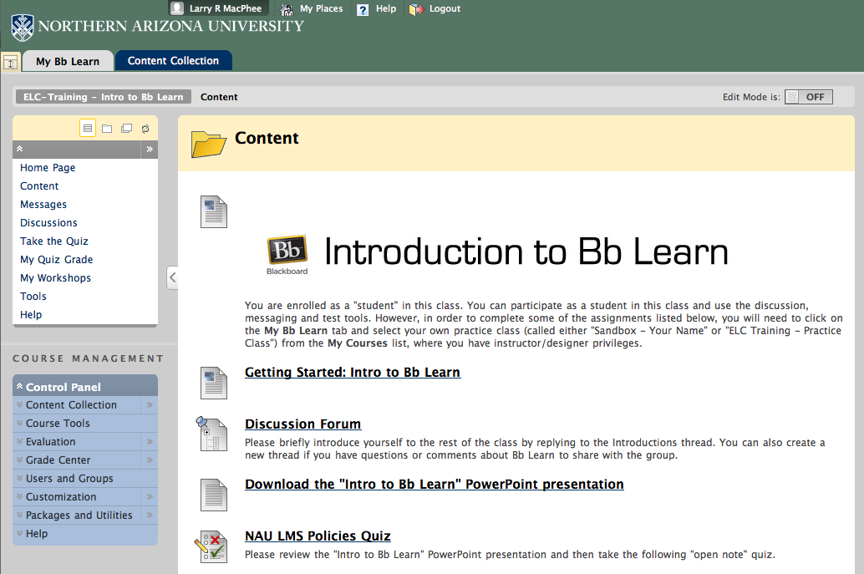
My online intro class
Notes:
Self-paced classes have clear instructions and ask participants to complete a series of activities. Instructors wait until they hear from the participant, and then check their work.

Slide 16
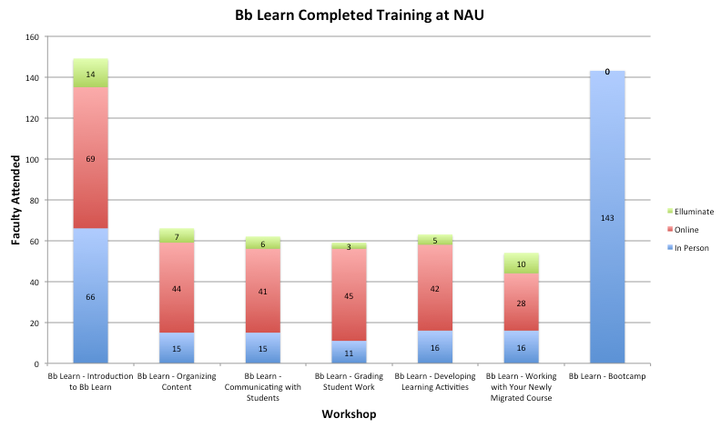
Results so far…
Notes:
Many people took our all-in-one in-person boot camp workshop to get it over with quickly, but satisfaction was higher for the shorter more focused sessions with lower enrollment.

Slide 17


Tutorials
Bb Learn On Demand
Step-by-Step Guides
Notes:
In addition to Blackboard’s Learn On Demand video tutorials, we also created a series of printable “step-by-step” tutorials.

Slide 18
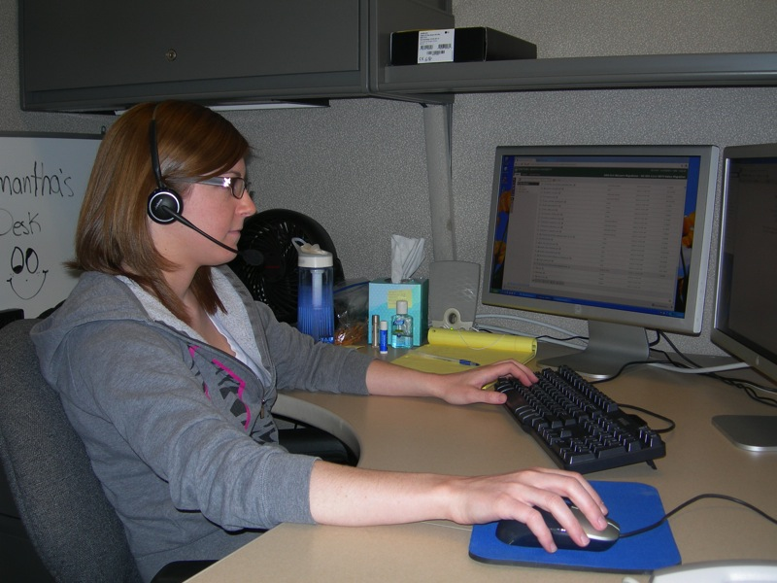
Faculty Support
Great student workers :D
Notes:
Student workers answer the phones and assist faculty with basic questions. We create tickets and escalate to consultants when the answers are more involved.

Slide 19
Lessons Learned
Money is a good incentive!
Money is a terrible incentive!
Student workers are great!*
Make the Intro course a pre-req
Building course shells is tedious
Online self-paced is popular
Boot camps are very popular
Notes:
*we have some established protocols to ensure that students don’t access courses in their own program.
*all proxy activities are logged.
*the hardest thing with students is that we hate to see the good ones graduate :D

Slide 20
Questions?

